Slide 1
SQL: Tables
PPOL 5206: WK04

Slide 2
Structured Data
Databases and Properties

Slide 3
Structured Data
Often used in business applications
Covers lots of transactional data
Tax & Accounting data
Often what people first think of as “data”
Popularized by spreadsheets
Efficient for queries, joins, aggregations

Slide 4
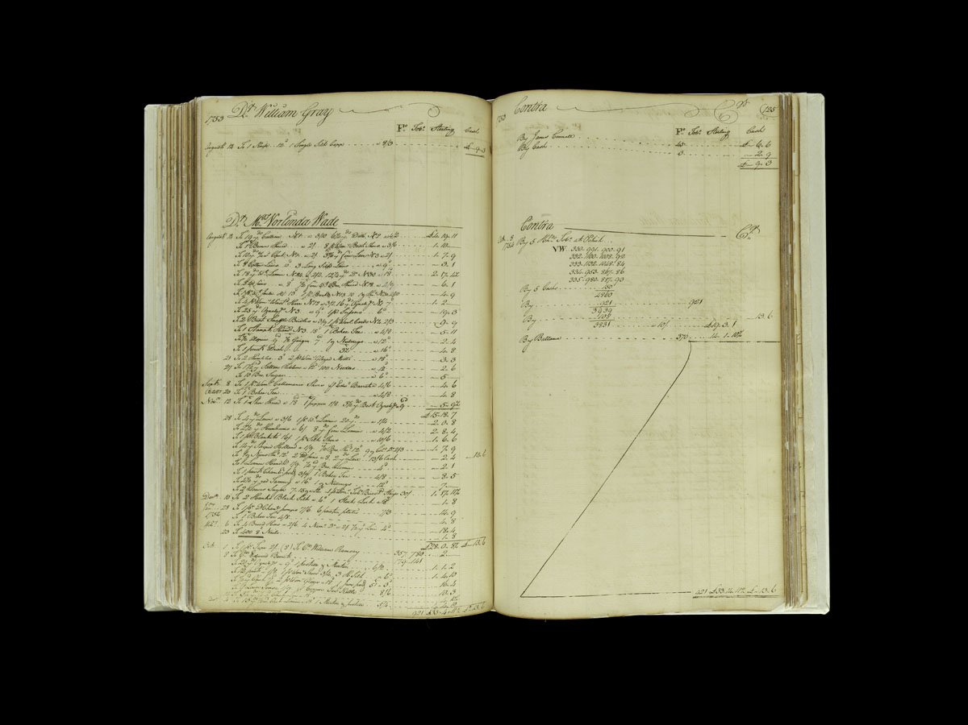
Data: 1756
Source:
Baddledors, twig whips, and yards of thunder and lightning: Decoding a colonial ledger | National Museum of American History (si.edu)

Slide 5
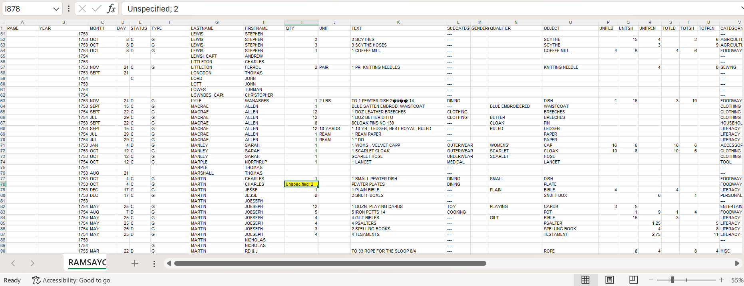
Data: 2013
Source:
Ramsay Ledger (wisc.edu)

Slide 6
Relational Databases
Table based structure defined by a schema
Table: entity, relation
Rows (A specific instance of the entity): tuple, record, observation
Columns (A single piece of data, of a particular type, for each row): field, attribute, feature, variable
Primary keys identify each row
Foreign keys allow linkage between tables
Enforce data integrity and consistency
Usually interact using SQL

Slide 7
ACID properties ensure data integrity (1)
Atomicity:
Each transaction is treated as a single unit, which either succeeds completely or fails completely.
If any part of a transaction fails, the entire transaction fails and the database state is left unchanged.
Consistency:
A transaction can only bring the database from one valid state to another, maintaining all the predefined rules.
If a transaction violates any of these rules, the entire transaction is rolled back and the database remains unchanged.

Slide 8
ACID properties ensure data integrity (2)
Isolation:
Transactions are securely and independently processed simultaneously without interference, preventing transactions from affecting each other.
Concurrent execution leads to a system state that would be obtained if transactions were executed serially.
Durability:
Once a transaction has been committed, it will remain so, even in the event of power loss, crashes, or errors.
This means that the changes made by the transaction are permanently recorded in the database's storage system and can be recovered in the event of a system failure.

Slide 9
SQL or Sequel
(NOT Structured Query Language)

Slide 10
SQL
Used for querying relational structured databases (RDBMS, RDS)
Database is composed of tables
Row x Column organization
Columns: Features/variables
Rows: Observations
Tables are linked by Keys
Primary
Foreign
Composite
SQL is a standard (ANSI, ISO)
But there are various brands that have their own syntax
MySQL, PostgreSQL, etc.
TOP vs LIMIT

Slide 11
SQL: Some History
Pre-1970: Hierarchical and network databases are dominant
Difficult to access data or change database structure
1970: Edgar (Ted) Codd describes the Relational Database Model
1970s: System R/SQUARE/SEQUEL developed
IBM develops System/38 (1979), SQL/DS (1981), IBM Db2 (1983)
1979: Oracle (then Relational Systems) releases Oracle V2
1986: Standardized by ANSI
1987: Standardized by ISO
2023: Most recent version of the “Database Language SQL” standard

Slide 12
Why learn SQL?
It is a necessary and desired skill in data jobs.
Ubiquity: SQL is widely used and supported by virtually all relational database management systems, making it a critical skill in the data field.
Accessibility: Its declarative nature allows users to focus on what data they want to retrieve, not how to retrieve it, making it easier to learn and use.
Interoperability: SQL provides a standard way to interact with databases, ensuring compatibility and transferability of skills across different systems.

Slide 13
SQL is foundational
An industry standard in working with databases
Some differences between versions
Can be run from
Its own IDE
Calls from other programs
Users might interact with a “wrapper” & be making SQL calls, even if they don’t know it
Not case sensitive,
But common style is to capitalize keywords: SELECT, FROM, IN, WHERE…
Might need “;” to end statements

Slide 14
SQL Languages

Slide 15
SQL Languages
SQL has different “languages” to work with different database functions
DDL – Data Definition Language
DQL – Data Query Language
DML – Data Manipulation Language
DCL – Data Control Language
TCL – Transaction Control Language

Slide 16
Two types of languages
DDL (Data Definition Language)
Defines the schema
Metadata
Commands affect entire table
CREATE, ALTER, DROP, TRUNCATE, …
DML (Data Manipulation Language)
Manipulate data in a database
Commands operate on rows
INSERT INTO, UPDATE, DELETE, SELECT, …

Slide 17
CRUD Functions (DDL, DML)
Common tasks in every database
Create
(CREATE, INSERT)
Read
(TRUNCATE, SELECT)
Update
(ALTER, UPDATE)
Delete
(DROP, DELETE)

Slide 18
DDL
Defining, altering, and deleting database structures such as tables, indexes, and schemas
Permanent changes; cannot be rolled back
Tables:
Keys
Variable types (VARCHAR, CHAR, INT …)
Other:
NULL, NOT NULL
Creating a database in “sales” schema
USE sales
CREATE DATABASE commissions
DROP TABLE IF EXISTS commissions.quotes
CREATE TABLE commissions.quotes
Specify Column Names and Data Types; identify the primary key
CREATE INDEX
Indexes allow faster sorting & data retrieval, but increase write time

Slide 19
DML
Run much more frequently than DDL
Day to day operations
Manipulates data in a database:
Adding/Inserting
Modifying/Updating
Deleting
Querying the data to produce subsets or summary statistics
DQL?

Slide 20
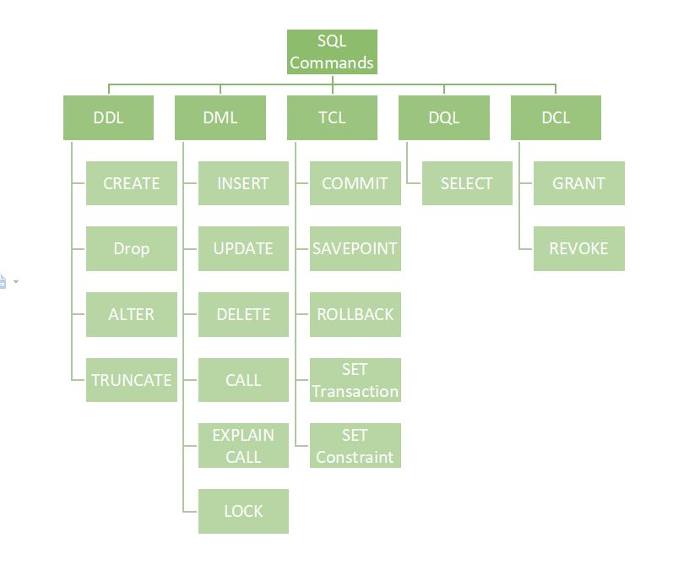

Slide 21
SQL Data Types

Slide 22
Common SQL Data Types
TYPE | EXAMPLES
INT | 1, 100, -30
FLOAT | 2.87, 3.14, -0.0001
VARCHAR(N) | ‘SQL’, ‘hello’
CHAR(N) | ‘SQL’ + (padding)
TEXT | ‘Ipso lorem fascuit…’
BOOLEAN | TRUE, FALSE
DATE | 2025-01-30
TIME | 18:30:00
DECIMAL | 123.45, -0.014

Slide 23
NULL Values
No Data, NA, N/A
IS NULL, IS NOT NULL
SELECT name FROM Customers
WHERE phone IS NULL
;

Slide 24
The BIG SIX SQL Clauses

Slide 25
SQL Questions & The BIG SIX
Question | SQL Commands (BIG SIX)
What data do I want? | SELECT
Where should the data come from? | FROM
Do I want all the data? | WHERE
How are the observations related? | GROUP BY
Do I want all the groups? | HAVING
How should the results be sorted? | ORDER By

Slide 26

SELECT * FROM * WHERE * GROUP BY * HAVING * ORDER BY

Slide 27
Choosing the attributes: SELECT
Indicates which expressions are retrieved from the data source
Expressions
Pre-existing
Derived
SELECT [features] FROM [tables]
SELECT * FROM Customers;

Slide 28
SELECT DISTINCT
Deduplicates returned values
SELECT DISTINCT city, country,
FROM customers;
Selects a single (first) observation for the identifiers
Order can be changed to alter which observation is first

Slide 29
Aggregate Functions
MIN()
MAX()
COUNT()
AVG()
SUM()
Combine with GROUP BY to get values for subsets
HAVING: Apply conditions to aggregate functions/GROUP BY
(WHERE applies to Rows, HAVING applies to aggregates)

Slide 30
Aliases
SELECT column AS alias
For variables and tables
Useful in joins
SELECT o.Order, o.Date., c.Name
FROM Customers AS c, Orders AS o
WHERE c.Name = “John”
AND o.CustID = c.CustID

Slide 31
LIMIT
Limits the number of responses returned in a query
(Might) save on resources
SELECT * FROM orders LIMIT 10;

Slide 32
Choosing the data source: FROM
Indicates the object from which the expressions in the SELECT clause are sourced
Pre-existing tables
Derived Tables
Subqueries
Common Table Expressions (CTEs)
Views
Joined Tables

Slide 33
Subsetting the data: WHERE
Evaluates rows in the table
Filters rows that meet 1 or >1 conditions
=, !=, <>, >, <, >=, <=, IN, LIKE, BETWEEN
Like uses wildcards: %, -, [], …
BETWEEN includes endpoints
Can be combined with AND, OR, NOT operators
AND, OR filter on more than one condition
WHERE ID > 20 AND ID < 40
WHERE ID < 20 OR ID > 40
Use different variables:
WHERE Country = “USA” AND City = “Phoenix”
NOT reverses the condition
NOT > 10
SELECT * FROM Customers
WHERE CustomerID = 1;

Slide 34
CASE Expressions
Used to perform conditional logic within queries
Similar to “if” or “switch” functions in some languages
SELECT ProductName,
CASE Category
WHEN 'Electronics' THEN 'E'
WHEN 'Books' THEN 'B'
ELSE 'Other'
END AS CategoryCode
FROM Products;

Slide 35
Other CASE Uses
“Searched” Expressions
SELECT ProductName, Price,
CASE
WHEN Price > 1000 THEN 'Expensive'
WHEN Price > 500 THEN 'Moderate'
ELSE 'Cheap'
END AS PriceRange
FROM Products;
Aggregate Functions
SELECT COUNT(*),
SUM(CASE WHEN Price > 1000 THEN 1 ELSE 0 END) AS ExpensiveProducts
FROM Products;

Slide 36
Handling NULL Values with CASE
SELECT ProductName, Discount,
CASE
WHEN Discount IS NULL THEN 0
ELSE Discount
END AS final_discount
FROM Products
;

Slide 37
Grouping the data: GROUP BY
Groups the data by one or more attributes
Often used for aggregation
SELECT job_id
, SUM(salary) AS total_salary
, COUNT(id) as employee_count
, MAX(salary) – MIN(salary) AS salary_range
FROM employees
GROUP BY job_id
;

Slide 38
Filtering the groups: HAVING
Groups the data by one or more attributes
Often used for aggregation
SELECT job_id
, SUM(salary) AS total_salary
, COUNT(id) as employee_count
, MAX(salary) – MIN(salary) AS salary_range
FROM employees
GROUP BY job_id
HAVING salary_range > 30,000
;

Slide 39
Sorting Data: ORDER BY
SELECT City, Country,
FROM Customers
ORDER BY CustomerID;
Can be ASC or DESC
Multiple sorting:
SELECT * FROM Customers
ORDER BY Country ASC, Name DESC;

Slide 40
Sorting Data non-Selected Attributes
SELECT rep_id
, COUNT(order_id) AS order_count
, SUM(order_total) AS total_order_cost
FROM orders
GROUP BY rep_id
ORDER BY AVG(order_total) DESC
;

Slide 41
Custom Sorting Example
We want “US” to appear first in a list of alphabetically-sorted countries
SELECT
countries.country_name AS "Country Name"
FROM
countries
ORDER BY
CASE
WHEN countries.country_id = 'US'
THEN 0
ELSE 1
END,
countries.country_name
;

Slide 42
Editing the Data

Slide 43
INSERT
Adding 1 or >1 rows to a table
Can select from one table and insert into another
INSERT INTO dbo.Patient
(Surname, FirstName, DOB, Sex, Weight, Height, Vaccinated)
VALUES ('Hitson', 'George','2019-11-19', 'M', 13.9, 22.5, 'No'),
VALUES ('Hitson', 'Jenny','2019-11-19', 'F', 13.7, 22.3, ‘No’)
;

Slide 44
UPDATE
Change an attribute value for 1 or >1 rows
UPDATE dbo.Department
SET DepartmentName = 'Trauma and Emergency Surgery’
WHERE DepartmentID = 3
;
Can change all instances in a table

Slide 45
DELETE
Removes 1 or >1 records from the table
DELETE FROM Customers
WHERE country = “UK”;
Deleting all records?
DELETE FROM Customers;

Slide 46
SQL Order of Execution
SQL is declarative, not procedural

Slide 47
SQL Ordering logical vs written
SQL is declarative
The commands don’t operate in the order we write them
Logical/Execution order of operations is important for:
Performance Optimization:
The execution order ensures that operations like filtering and grouping occur before resource-intensive tasks such as sorting
Data Reduction:
Early filtering reduces the data set size for subsequent operations, improving efficiency
Accurate Results:
Incorrect execution order can lead to wrong outcomes

Slide 48
SQL Execution Order
FROM/JOIN
WHERE
GROUP BY
HAVING
SELECT
DISTINCT
ORDER BY
LIMIT

Slide 49
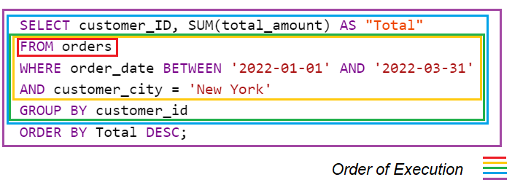

Slide 50
SQL Engine vs IDE
SQL Engine
The core software that manages data storage, retrieval, and execution of SQL queries
Handles query execution, indexing, transactions, security, and concurrency
Works in the background, processing queries, and ensuring data integrity
The SQL engine parses the query, optimizes it, and executes it.
The result is returned to the client.
SQL IDE
A user-friendly interface to interact with the database engine
Helps in writing, running, and debugging SQL queries
Provides visual tools for managing tables, views, indexes, and users
Sends SQL commands to the database engine.
Displays query results in a structured format.

Slide 51
SQL Dialects
MySQL
MariaDB
PostgreSQL
Oracle PL/SQL
MS SQL Server T-SQL
SQLite
IBM db2 SQL
Snowflake SQL

Slide 52
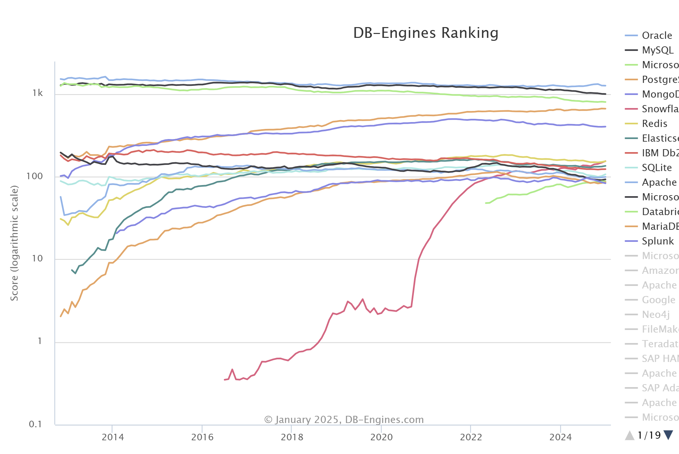
Popular Dialects

Slide 53
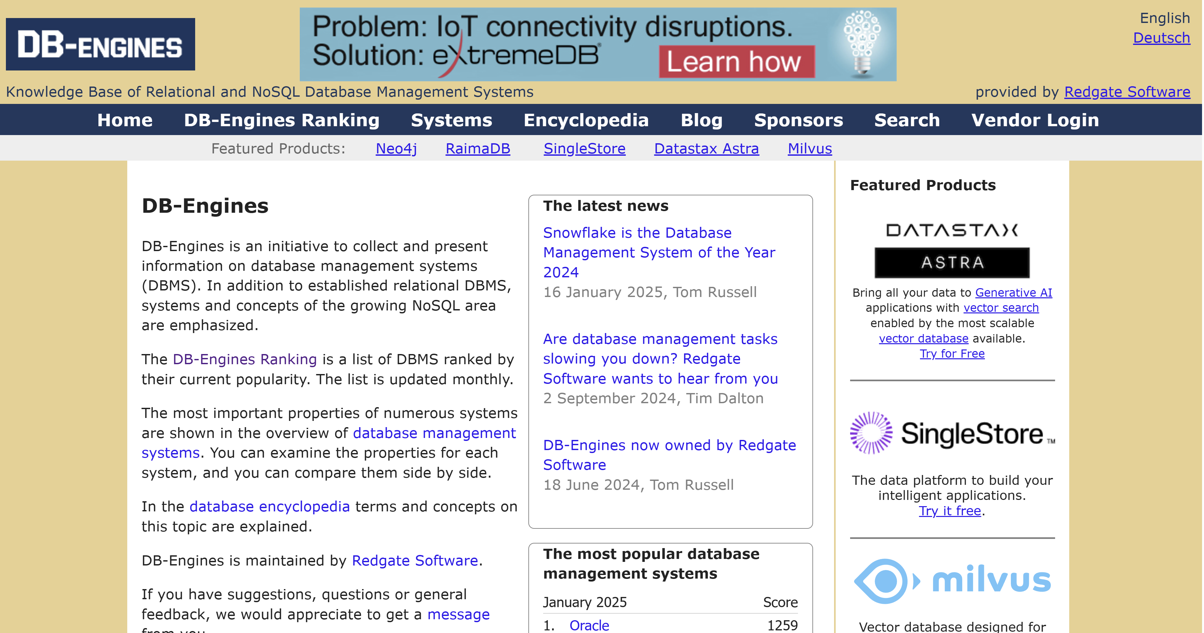

Slide 54
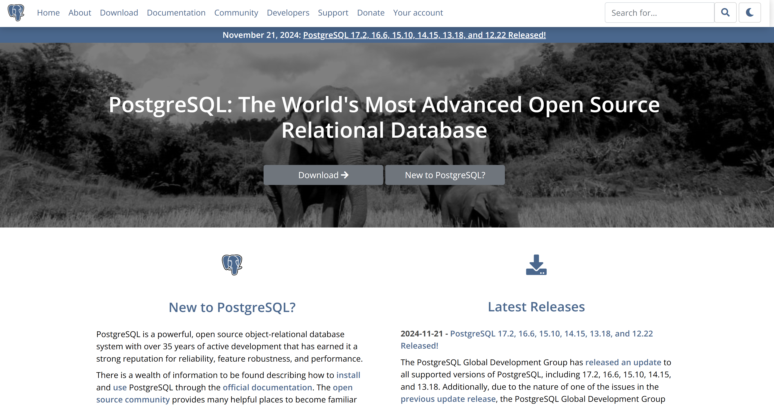
PostgreSQL (https://www.postgresql.org/ )

Slide 55
Which Version to Use?
Stability and reliability vs new features
Compatibility with existing systems
Risk of downtime and service disruptions
Compliance and regulatory requirements
Extension and plugin compatibility

Slide 56
Change Management
Upgrading might require a structured process
Evaluation and testing
Compatibility checks
Reviewing custom queries
Disaster recovery planning
Rollback plans
Training and documentation

Slide 57
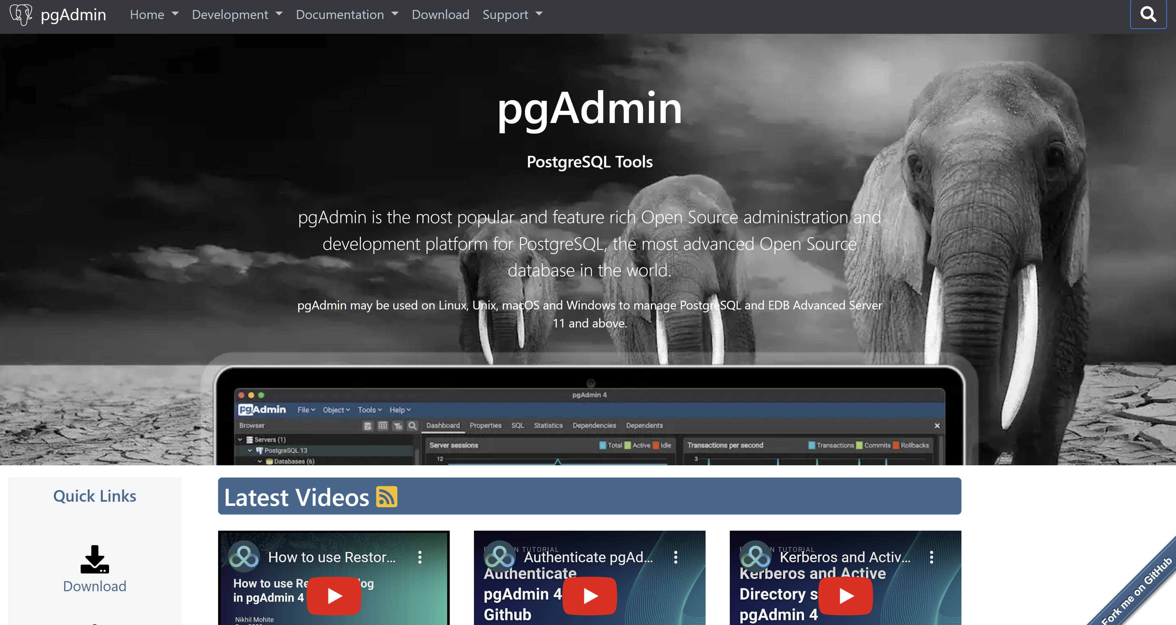
PGAdmin (https://www.pgadmin.org/ )

Slide 58
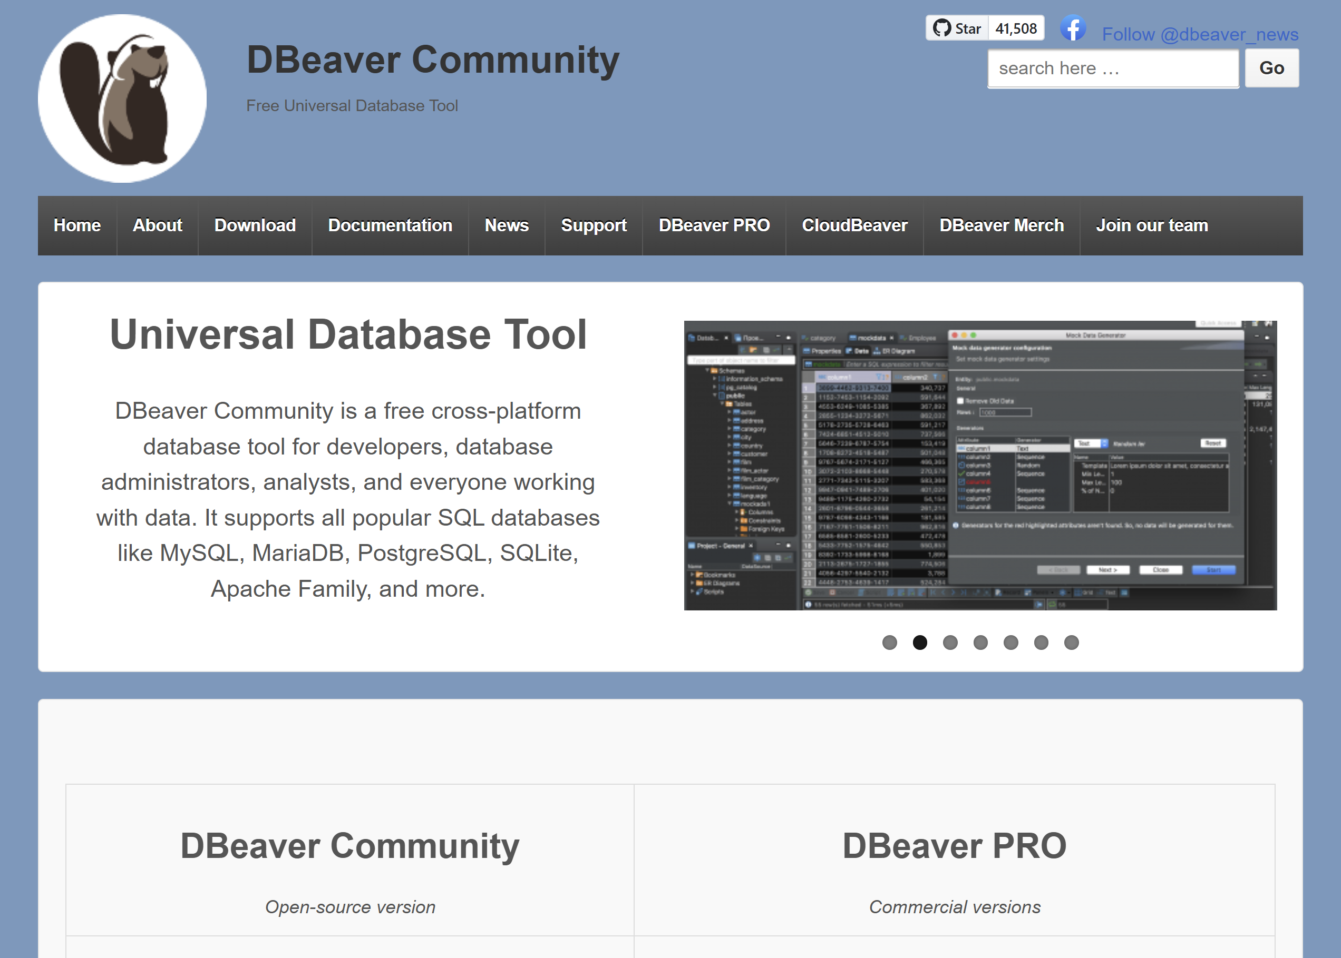
Dbeaver ( https://dbeaver.io/ )

Slide 59

Key Takeaways
SQL is a fundamental skill in data analysis
It works with structured databases
There are six main clauses in the SQL language

Slide 60

Next week:
Database theory
Data modelling
Joining tables
Subqueries
Temporary tables
CTEs
Views

